Slide 1
Reconstructing Institutional Research for
21st Century Needs:
A Case Study of Stony Brook University
Braden J. Hosch, Ph.D.
Asst. Vice President for Institutional Research, Planning & Effectiveness
Stony Brook University
International Conference on Higher Education and Innovation
February 5, 2015
Notes:
Good afternoon. I would like to thank conference organizers, especially Prof. Sang Hoon Bae and Ms. Hae Lim Chun for the opportunity to speak with you today. It is an honor for me to be in the company of Randy Swing, Don Hosler, and Vic Borden – all of whom are easily recognized as the best in the business in the United States.

Slide 2
Overview
Context
The importance of context
Office Profile
History
Mission and Goals
IR Fundamentals
Measurement
Tools and Methods
Internal
External
Data Management
University Profile
Notes:
The story I am here to tell you today about institutional research at Stony Brook University is one of evolution and reconstruction. You will hear about the types of data we manage and how we use them to advance the mission of the university, but importantly, you will also hear about the context that frames what we do. Quality institutional research operations are able to provide quantitative answers to questions, and these answers are accurate, precise, reliable, valid, and replicable. But these answers are also placed within a context because it is the context that gives the data meaning. This context is both semantic – which means there are firm and agreed upon data definitions behind our data, but they are also situated within an institutional and environmental framework.
I can even go on to say that the most effective institutional research activities provide quality information within a context, incorporating actionable information that can be used to construct or support a narrative.

Slide 3
STONY BROOK UNIVERSITY
PROFILE

Slide 4
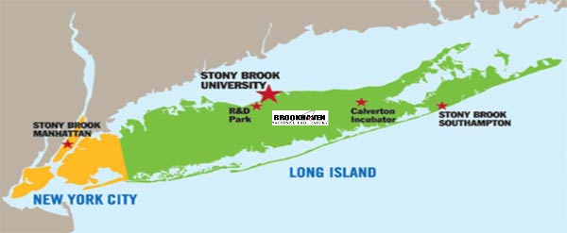
Stony Brook University
Source: Office of Institutional Research, Planning & Effectiveness
Notes:
Stony Brook’s main campus is 50 miles from New York City, with locations in Manhattan and Southampton on the eastern tip of Long Island. Stony Brook University is a relatively young institution. It was founded in 1957 as public college envisioned to support the preparation of teachers on Long Island, but by the mid-1960s, it took on a role to provide education for health and medical professions and a related mission to support life and physical sciences. The addition of a medical school and Health Sciences Center in the 1970s positioned the university to become what it is today.

Slide 5
University Profile
Part of State University of New York System
Co-Manager of Brookhaven National Lab
SUNY Korea (Songdo)
Highly Ranked – U.S. News & World Report:
#88 National, #131 Global
Notes:
Stony Brook is one of four major university centers in the State University of New York System, and the most selective public university in the State of New York. The university is a member of the prestigious American Association of Universities – the 62 most prominent research universities in North America. We co-manage the Brookhaven National Laboratory, which houses a particle accelerator and focuses on energy security, photonic sciences, and climate bioscience. Stony Brook is also the principal partner in SUNY Korea, the first American university established on Korean soil. It is also the first university to join the Songdo Global University Campus (SGUC). The range of world-class research, teaching & learning, and advancement of knowledge have propelled Stony Brook’s national ranking to be among the top 100 universities in the United State (in the top 40 among public universities), and our global ranking is also enviable at #131 as rated by U.S. News & World Report (2014).

Slide 6
Organization
West Campus Colleges/Schools
Arts & Sciences
Business
Engineering & Applied Sciences
Journalism
Marine & Atmospheric Sciences
Professional Development
Schools in Health Sciences Ctr
Dental Medicine
Health Tech & Mgt
Medicine
Nursing
Social Welfare
(225 Degree & Certificate Programs)
Notes:
Stony Brook University has a West campus that houses six colleges and schools, and an East campus where the Health Sciences Center is situated that houses five additional schools, including a school of medicine, a school of dental medicine, a school of nursing, a school of health technology management, and a school of social welfare. The University’s Graduate School has purview over all Ph.D. and some master’s programs on both campuses. At present 225 degree and certificate programs are active.

Slide 7
Student And Degree Profile
Source: Office of Institutional Research, Planning & Effectiveness
Notes:
In fall 2014, 24,607 students were enrolled, about a third of these are graduate students. We awarded 6,475 degrees and certificates last year. Almost a third of these are in Science, Technology, Engineering & Mathematics or STEM fields. About a quarter (24%) were in social and behavioral sciences. A fifth (20% were in health and medicine). The remaining quarter of conferred awards were in arts, humanities & communication, business fields, and a variety of other areas.

Slide 8
Other Highlights
Employees: 14,500, including hospital | Annual Budget: 2.3 billion USD
Faculty: 2,500 Total 1,100 Tenured/Tenure Track | Annual Research Expenditures: 220 million USD
Student-Faculty Ratio: 16:1 | Graduation Rates: 50% in 4 years 68% in 6 years
Source: Office of Institutional Research, Planning & Effectiveness
Notes:
Stony Brook has an annual operating budget of over $2.3 billion (USD) and has $220 million in annual research expenditures. The institution has over 14,500 employees, with 2,500 faculty. 1,100 of these are tenured or on tenure track. Stony Brook is finishing a five year plan to hire 250 tenured/tenure-track faculty members, and the student faculty ratio (as measured by IPEDS) has been lowered from 18:1 to 16:1. Student graduation rates (for first-time students starting and finishing at Stony Brook) far exceed the national average, and Stony Brook is a rare institution in the United States where socioeconomically challenged students (those receiving Pell grants) graduate at higher rates than those with more economic resources. Achievement gaps between white students and racial and ethnic minorities seen throughout American higher education are not present at Stony Brook. African American or Black Students graduate at higher rates that white students and graduation rates for Hispanic students are comparable to whites. The University is engaged in an ambitious project to increase the 4-year graduation rate from an average of 46% to 60% by 2018.

Slide 9
OFFICE OF INSTITUTIONAL RESEARCH, PLANNING & EFFECTIVENESS

Slide 10
History of IR to 2010
Office of Institutional Research
5 FTE* Employees – Director, Assoc. Director, 3 Analysts
Primary tools: SPSS, SAS
Data storage: SPSS files
Primary functions:
Compliance reporting
Ranking surveys
Presidential support
“We deal with numbers without the dollar sign”
* FTE = Full-Time Equivalent
Notes:
Through 2010, Stony Brook University maintained an Office of Institutional Research (OIR) without planning and institutional effectiveness functions. This office reported to the president until 2007. The former leadership maintained that the (unwritten) mission of the office was to provide reporting and analysis of enrollment, completion, and staffing data but not financial information. A change in leadership in 2008 moved the office to the Provost’s division.

Slide 11
Transformation
2010
Budget cuts
Staff departures
2011-13
Interim leadership / Receivership
2014
New mission
Staff restoration
Data Governance
Expanded Scope
2013
Reorganization
Office of Institutional Research, Planning & Effectiveness
Notes:
When the Provost departed in 2010 and the full force of budget cuts from the Great Recession came into full force, the Director, Associate Director, and an analyst departed from the university. The office was housed for two years on an interim basis in the Information Technology Division, overseen by the same manager overseeing the Data Warehouse. In early 2013, the office was moved under the VP for Strategic Initiatives, and in late 2013 I was hired as the new Assistant Vice President for Institutional Research, Planning, and Effectiveness. The latter two functions represent an increase in scope.
In 2014 we established a new mission, restored staffing to 5.0 FTE, launched a data asset assessment and task force to make recommendations about data governance and quality and expanded the scope of the office to encompass planning and institutional effectiveness.

Slide 12
Institutional Research
Full-Time Staff 2009 - 2016
*FY 2016: 5 FTE, plus 1 requested
Notes:
A brief history of our staffing levels in our office shows that office staff reached a low of 2.0 FTE employees during FY 2012-13. This level of staffing was insufficient to carry out basic requirements with an acceptable level of accuracy and reliability. Smaller institutions can certainly run successful IR operations with two or even one IR staffer, but one IR FTE employee per 10,000 student FTE is insufficient. Even at the planned level of increase to 6.0 FTE, Stony Brook’s IR function will fall in the bottom third of the public AAU institutions for IR staffing.

Slide 13
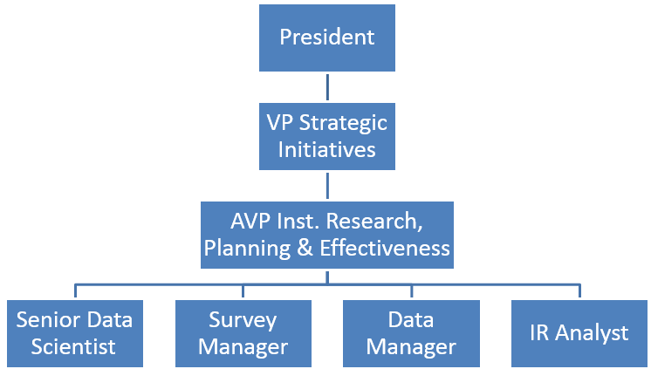
Organization Chart: Institutional Research, Planning & Effectiveness
Notes:
The Office of Institutional Research Planning & Effectiveness reports to the Vice President for Strategic Initiatives and is housed in the Division of the President. Housing the IR function in direct line of oversight from the CEO usefully places IR outside of direct control of areas competing for resources and can improve the perception of impartiality.
In transformation of the office, the data manager position was added. The senior data scientist position represents transformation of an existing reporting analyst.

Slide 14
Mission and Vision
Mission
To collect, analyze, organize and communicate data and information to provide a valid, consistent, and accurate understanding of how the institution is advancing its mission in support of its vision to become a top-ranked public research university.
Vision
To establish a world-class institutional research operation and institutional effectiveness system in support of the University’s mission.
Notes:
I do not typically read presentation slides, but the words in the mission are important enough to do so. The mission of the Office of Institutional Research, Planning & Effectiveness is to collect, analyze, organize and communicate data and information to provide a valid, consistent, and accurate understanding of how the institution is advancing its mission in support of its vision to become a top-ranked public research university.
Collection of data is often overlooked and underrated as an IR function but it is essential to support all subsequent functions. Organization of information as well is critical especially in larger, more complex organizations. Analysis is an activity traditionally associated with IR offices, but communication can at times be overlooked or inadequately accomplished. The office not only reports data but generates information. Values for generating a valid, consistent, and accurate understanding are explicit in the mission of the office. Importantly, the office focuses on how the university accomplishes its mission, providing a wide scope but one that allows activities to be tied back to the shared vision for advancing the university. The vision simply is to become a world-class IR operation. Elite universities rely upon functional units to perform at a similarly elite level to deliver and maintain high quality services.

Slide 15
Goals
3. Decision Support & Internal Data Requests
2. External Reporting & Accountability
1. Data Management
4. Research
5. Institutional Effectiveness
6. Strategic Planning Support
Notes:
The goals that follow from the office mission have some elaboration in what activities will be carried out:
Data Management. Ensure data quality and availability.
External Reporting & Accountability. Achieve 100% compliance with regulatory and other external reporting requirements.
Decision Support & Internal Data Requests. Develop a culture that relies on evidence-based decision-making.
Research. Conduct research to support significant institutional priorities.
Institutional Effectiveness. Establish and maintain a multi-level institutional effectiveness system that promotes intentionality and deliberate improvement.
Strategic Planning Support. Support strategic planning efforts through metrics development, measurement, communication of progress, and forecasting.

Slide 16
INSTITUTIONAL RESEARCH
FUNDAMENTALS
Notes:
A very brief overview of some of the fundamentals that provide a foundation for our work will help provide a better understanding of the tools and approaches I will cover later in the presentation.

Slide 17
Values For Projects
Accurate
Responsive
Timely
Reproducible
Contextualized
Notes:
Several values are implicit in the activities and projects we carry out. We highly value accuracy and adhere to an organizational code of ethics that obligates us to disseminate only accurate data and information. Projects also must be responsive to constituencies requesting research. This often involves some discussion and conversation to understand and sometimes clarify research questions and intended uses. The office tracks project time to delivery and on-time delivery rate because in many cases information requested is required to make time-sensitive decisions. We strongly value reproducibility so that other analysts or third parties can replicate our findings; this level of scientific rigor requires documentation of data sources and methods. Finally data must be placed in context, often involving benchmarks of performance from other institutions. Outside of a semantic frame, data mean very little. Our job is not merely to report numbers but rather to create meaning and generate actionable information where possible.

Slide 18
Measurement Concepts
Definition
Time period
Measurement Point
Documentation
Notes:
Also among IR fundamentals are the concepts of data definitions, time periods, measurement points, and documentation. For example, the very basic question, “what is the size of your institution’s enrollment?” requires grounding in all four od these concepts.
From the definitional standpoint, what does it mean for a student to be enrolled? Do students taking exclusively non-credit courses count as enrolled students? What about students away from campus on study abroad programs? Cases such as these have to be addressed in the definition of an “enrolled student” and preferably these definitions are anchored to an external standard.
In terms of time period, we know that our enrollment changes from semester to semester and from year to year. Is the question about fall enrollment or spring enrollment? (Fall is almost always higher). This year, last year, or some other period?
Even within the semester, enrollment changes day-to-day, if not minute-to-minute. In order to have a consistent answer for questions like this, we typically select a consistent measurement point or census date in each semester to measure the enrollment.
Finally, documentation in the form a data dictionaries and procedure manuals must accompany these measurement systems. Reports that include the numbers should document sources and methods where applicable.

Slide 19
Data Management
To 2008 | 2008-2013 | 2014-16 | 2016
Flat files in organizational silos Manual error checks Reports from transactional systems | Relational data warehouse Limited quality assurance Uneven protocols for data freeze | Relational data warehouse Data governance and Quality Assurance strengthened Data freeze protocols extended | Addition of external data sources: National databases AAUDE Academic Analytics
Notes:
Data management also is a fundamental activity of institutional research, and this function at Stony Brook has been evolving over the past six to eight years. Prior to 2008, the university typically stored IR data in flat data files in organizational silos. Data quality was maintained principally through manual error checks of these files and often reports were simply generated from transactional systems. In 2008, the University implemented a relational data warehouse, and since my arrival, we have launched protocols to shore up data governance and quality assurance. Once more formal data governance systems are in place, we expect to begin adding external data sources to the warehouse for use in that environment.

Slide 20
Principal Data Types
Administrative Enterprise Data
(PeopleSoft)
Survey Data
(NSSE, student opinion, alumni)
Environmental Data
(IPEDS, rankings, data exchanges
Administrative Ancillary Data
(Blackboard, Social Media)
Notes:
Data Types
Administrative Enterprise
(PeopleSoft)
Why → Core university mission/business, compliance reporting, decision support
Survey
(NSSE, CIRP, satisfaction, alumni)
Why → Context, causality, quality
Environmental
(IPEDS, rankings, data exchanges)
Why → Comparison, context
Administrative Ancillary
(Blackboard, Social Networking)

Slide 21
External Reporting/Accountability
Federal | State | System | Rankings
Summary Stats Enrollment Completions Financial Aid Graduation Rates Human Resources | Summary Stats Enrollment Completions Financial Aid | Unit Records Enrollment Courses Completions Financial Aid Summary Stats Applied Learning Non-Credit Student Surveys | Summary Stats Common Data Set Research Various
Notes:
External reporting and accountability falls generally into four areas: federal, state, system, and rankings publications. For our university, federal and state level reporting entail preparation of descriptive summary statistics collected by government entities through surveys (IPEDS, NYSED). As a member of the SUNY system, we are required to provide unit record data for students and employees to the system office, which prepares reports for the governing board and the legislature. Over 100 external surveys for rankings publications and other organizations are completed by our office each year, and these too typically entail preparation of summary statistics.

Slide 22
INTERNAL TOOLS AND METHODS

Slide 23
Internal Tools
Data Warehouse
Internal Reporting & Analytics
Web site
Internal & External Communication
Static & Dynamic Pages
Dashboards
Compact Communication / Monitoring
Notes:
This segment of my presentation covers how we get our job done. The vast majority of our day-to-day activities rely on the tools I’m going to discuss.

Slide 24
Software
Basic Tools
MS Excel
MS Office
Google Drive
Adobe Acrobat
Statistical
SPSS (base)
AMOS
Decision Trees
Missing Data
SAS
Specialized
Tableau
Visual Analysis
QGIS
Circos, Google Charts
Notes:
Fundamentally, we rely heavily on the Microsoft Office Suite for preparation of reports, production of descriptive statistics, and preparation of tables and graphs. File sharing is largely accomplished through email, Google Drive, and our web site. More statistically complex activities use SPSS and SAS. Data mining, inferential statistics, and analysis of large surveys and data sets rely on these packages. We also use some specialized products noted on the slide. Tableau Visual Analysis for Databases is growing more important for us as we use it increasingly to build dynamic tables and charts for web publication.

Slide 25
PeopleSoft (ERP)
Data Warehouse
Managed by Unit in Information Technology
Campus Support with Emphasis on Finance
Daily Updates from PeopleSoft
Internal Decision Support
Current Limitations
Not aligned with external data standards
Important data does not freeze
Data governance
Static
Reporting
Data Warehouse
Business Intelligence /
Dynamic Reporting
Notes:
The University investing in data warehousing beginning in 2006, with broad implementation by 2010. The project was largely driven by the Financial Affairs division. IR stopped managing its own data beginning in 2011. The warehouse extracts selected data, almost exclusively from PeopleSoft – our enterprise system – houses the data in a MySQL server array and is set to produce a range of mostly static reports through SBU reporting. In 2013 a more robust dynamic reporting tool was implemented. The warehouse is managed by a Decision Support unit in Information Technology with 5.0 FTE, all of whom principally operate as SQL programmers
This infrastructure is incredibly valuable and has huge potential for leveraging. Nevertheless, several limitations first need to be overcome: 1. data definitions are not aligned with federal or system standards, thus the warehouse cannot replicate publicly available reports about enrollment, completions, staffing, etc. This leads to enormous analytical confusion. Some data sets like enrollment are set to freeze on a given census date, but completions and human resources are not, and so the same query run at a different time will produce different answers. Finally the governance of data in the warehouse and the source data that supplies it is missing key formalized structures and policies to ensure data quality, meeting business requirements, etc.

Slide 26
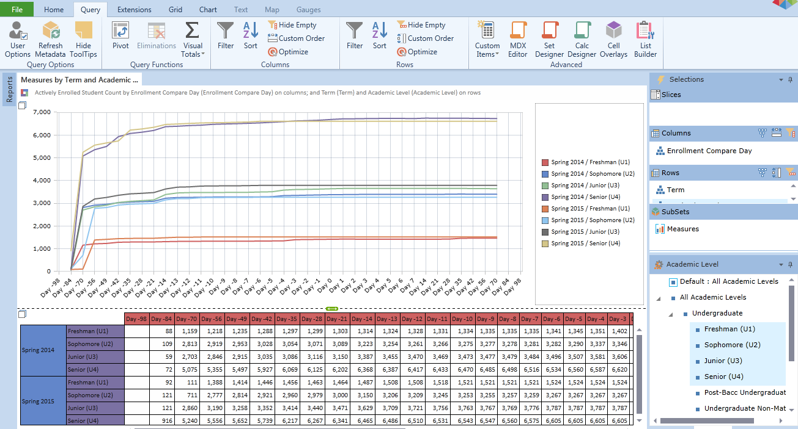
Pyramid Analytics
Source: Pyramid Analytics
Notes:
Dynamic reporting is available from the data warehouse using a platform called Pyramid Analytics. The screenshot above depicts same-time enrollment rates by class level based on the number of days prior to the start of the fall term. The actual data here are unimportant for the topic today other than to show a dynamic reporting tool is connected to the warehouse resource. As previously noted, a significant limitation of the current resource is that it does not account for external reporting standards or business rules and so it does not generate statistics that count the way the U.S. government counts students or the way the governing board counts students. Effecting this alignment is one of the outcomes that should emerge from the data governance project. It is also inaccessible from a physical location other than our main campus.

Slide 27
Strengthening Data Infrastructure
Cross-functional task force in 2015 to recommend institutional policies and structures
Communication
Data Quality
Data Governance
Notes:
Data governance is the formalizing behavior around the definition, production and usage of data to manage risk and improve the quality and usability of selected data. (Robert Seiner, TDAN). It includes
specification of decision rights
an accountability framework to ensure appropriate behavior
valuation, creation, storage, use, archiving and deletion of information
processes, roles and policies, standards and metrics that ensure the effective and efficient use of information (Gartner)
Stony Brook’s project to strengthen its data infrastructure will examine existing governance structures, including active and inactive groups and lines of responsibility.
A review will be conducted of existing processes, practices and procedures that significantly impact data management and stakeholders.
Roles of cross-functional groups will be identified and articulated; functional roles in business units (e.g. data owner, data custodian, report owner) will also be identified and articulated.
A formal governance structure following from agreed upon mission and goals will be drafted, approved, implemented, and posted on a website to codify roles and responsibilities.
The process for prioritization as well as adoption and adjustment of standards will be examined, adjusted as needed, and formalized

Slide 28
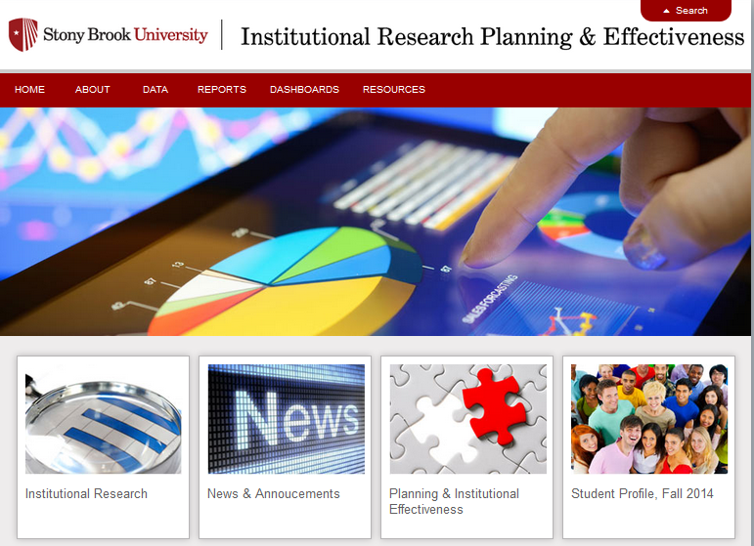
Web Site
Areas for:
About
Data
Reports
Dashboards
Resources
http://www.stonybrook.edu/commcms/irpe/index.html
Notes:
In late 2014, the office website was moved out of an FTP environment with editing in Dreamweaver and into the University content management system. The website is still under significant development and will likely not reach a more optimal functionality until fall 2015.

Slide 29
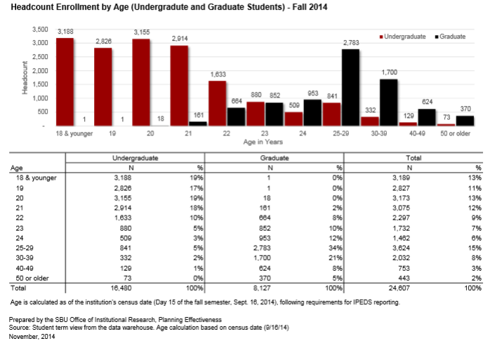
Static Web Pages
Notes:
Static web pages provide readily accessible frequently used or needed statistics. These are important since some devices and browsers can misbehave with dynamic pages. They are also important to preserve history and data integrity. Maintaining a dynamic web resource for 1-2 years is easy and expected. Maintaining it for 20-30 years can be challenging. IR is regularly called upon for historical comparisons over several decades, and so ensuring data are usefully and readily archived for the IR staff of the future is among our responsibilities and obligations.

Slide 30
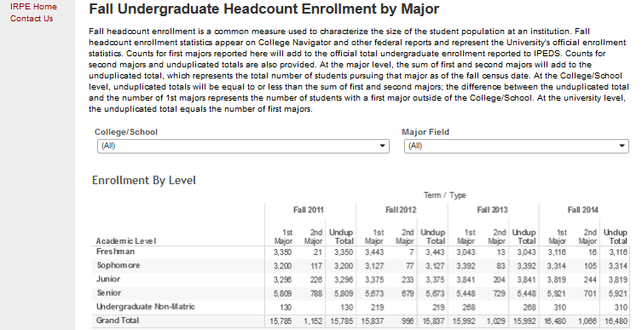
Interactive Web Pages
Notes:
Interactive pages are targeted for significant expansion in 2015. These provide readily available self-service information to public – how many English majors by level over time? By demographics? They ease the burden of reporting and follow the basic premise that if an individual can buy a book on Amazon.com, then they should be able to find out targeted information about Stony Brook University.
This example depicts undergraduate fall headcount enrollment for four years. The table shows double majors and unduplicated totals. It was prepared in Tableau desktop and was published using Tableau Public.
Hyperlink to interactive page: http://www.stonybrook.edu/commcms/irpe/data/enrollment/fallUGbyMajor.html

Slide 31
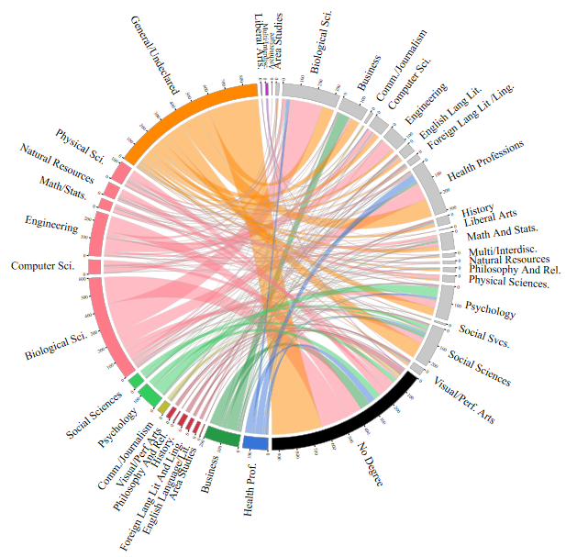
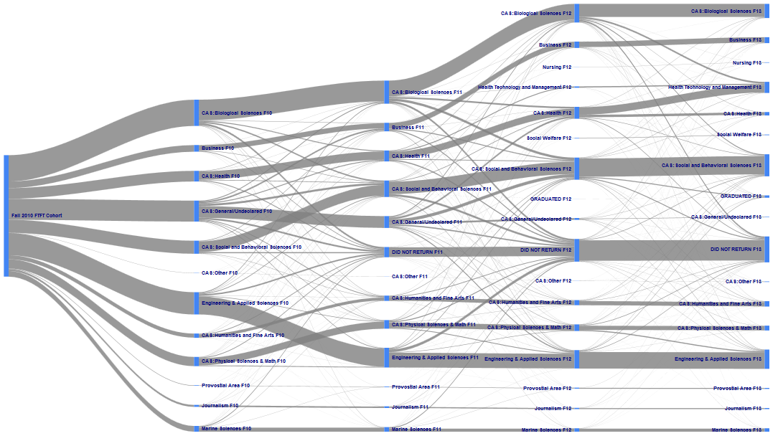
Interactive Visualizations
Degree Outcomes by Initial Major
Freshmen Entering in Fall 2007
Major Migration, Freshmen Entering in Fall 2010
Notes:
Data visualizations are also targeted for expansion as web resources. These two visualizations show:
Degree outcomes of full-time, first-time students entering in fall 2007: http://www.stonybrook.edu/commcms/irpe/reports/degree2007.svg
Major Migration Sankey Diagram – FT FT students entering in fall 2010:
http://www.stonybrook.edu/commcms/irpe/reports/F2010Migration.htm

Slide 32
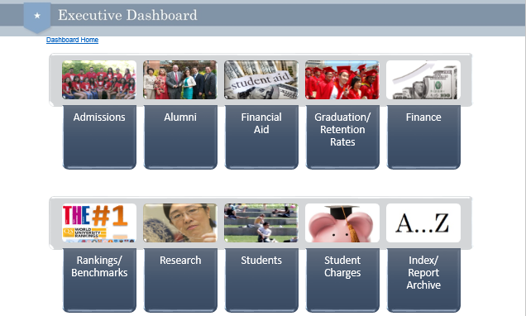
Executive Dashboard
Source: Stony Brook Executive Dashboard
Notes:
Dashboards are the rage, principally because good dashboards clearly and quickly communicate information. Because many of our cycle times in higher education are annual or bi-annual, the notion of an updating dashboard may overstate the timeliness of the instrument. Nevertheless, preparation of data in this way is increasingly a requirement for successful IR offices. This particular dashboard provides the president and his direct reports with high level information linked to key university goals. It is a mix of static pdf documents managed in Google Drive that link to some dynamic resources. Business requirements for this dashboard included rock-solid access from off-campus and on mobile devices.

Slide 33
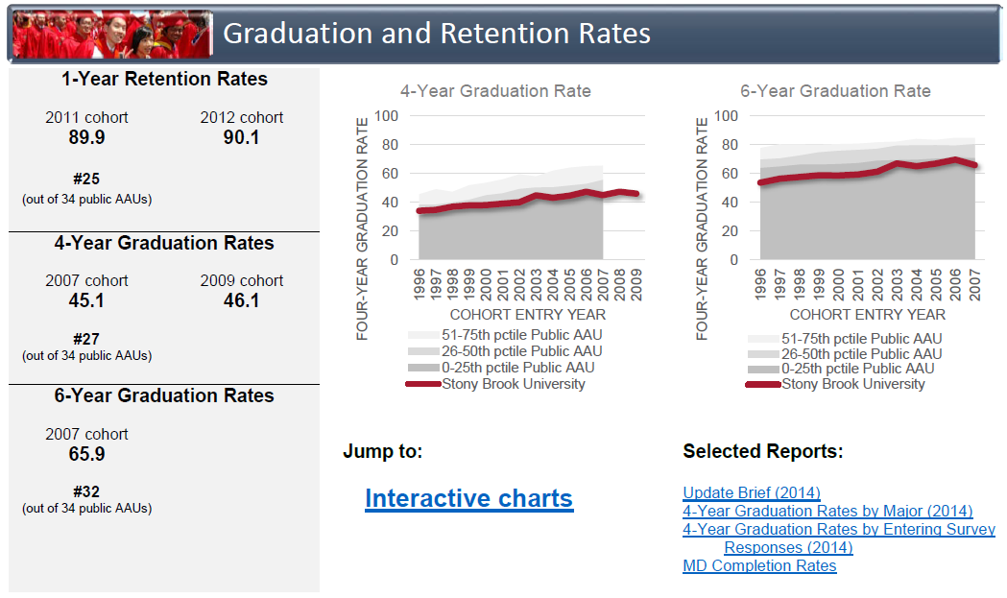
Source: Stony Brook Executive Dashboard
Notes:
This detail from the Executive Dashboard shows graduation and retention rates for full-time, first-time students. Links to the interactive tools are provided as well as links to recent reports about related topics.

Slide 34
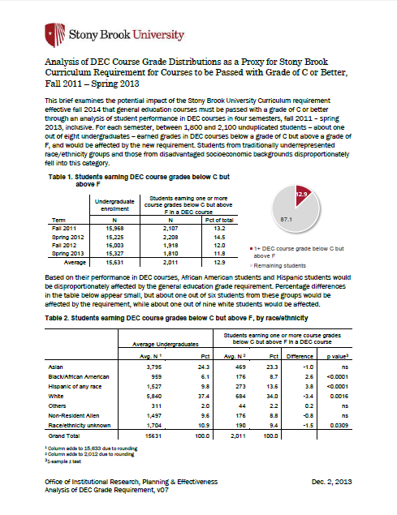
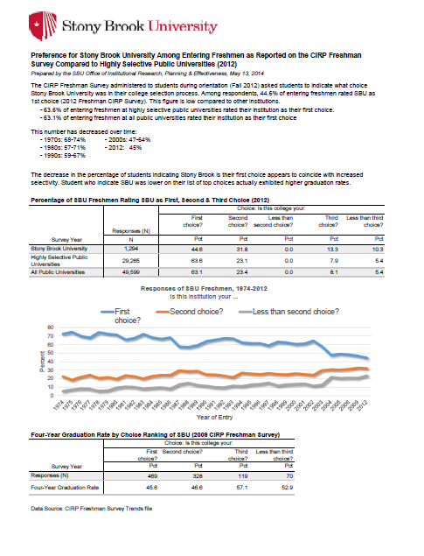
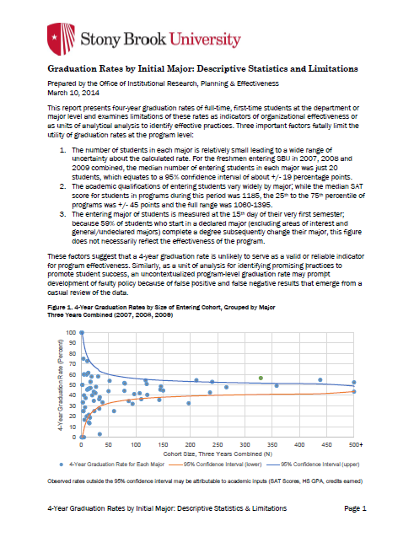
Research
Research reports and briefs support institutional needs and priorities
Analysis of general education course success to forecast policy impact | Stony Brook Univ. as 1st, 2nd 3rd choice of admitted students, 1971-2012 | 4-year graduation rates by initial major and limitations
Notes:
Conducting in-depth research or program evaluation and issuing reports on findings are also a regular activity. These three examples (which I did not intend to be legible as slides but rather shown for purposes of layout) covered: general education, admissions, and graduation rates by initial major.

Slide 35
EXTERNAL TOOLS AND METHODS

Slide 36
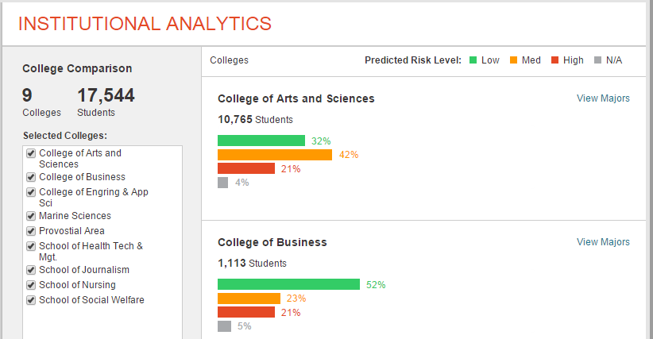
Student Success Collaborative
Source: Educational Advisory Board Proprietary Tool
Notes:
The Student Success Collaborative from EAB is an example of a third-party data mining operation harnessing institutional data to provide information to campus constituencies. IR has a role in data validation (are they using the right data sources?) and also model validation (are their models effective at improving graduation rates? What are the rates of false positive and false negative results?). A question currently under discussion is what is the measure of “risk” that this model treats as a dependent variable? Is it appropriate? How well does the model predict it?

Slide 37
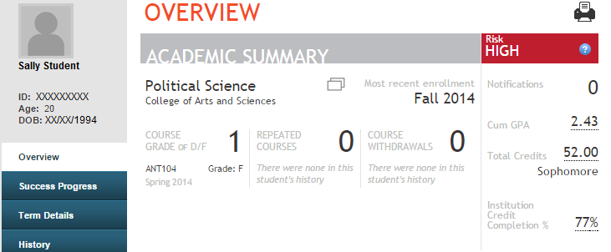
Student-Level Analytics
Student Success Collaborative Screenshot
Source: Educational Advisory Board Proprietary Tool
Notes:
Student level data are available to advisors, who can create watch lists.

Slide 38
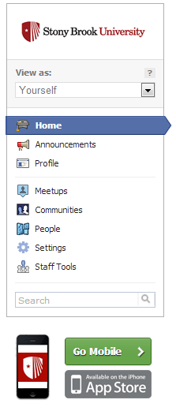
Social Media Analysis
Private social network for admitted students within Facebook, hosted by Uversity
Students build their own communities around shared interests
Native mobile apps and multichannel announcements
Notes:
Enrollment management makes heavy use of social media and increasingly has large unstructured data available that can usefully be parsed with “big data” analytical methods.

Slide 39

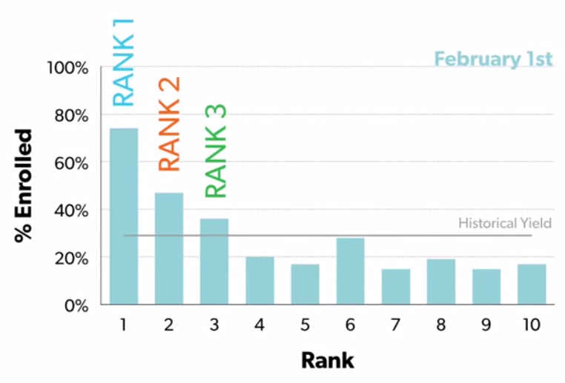
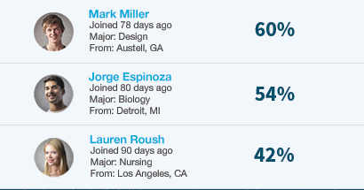
Enrollment Probabilities
App provides rank and probability to enroll
Categorizes students for outreach
Notes:
Like the role of IR with the EAB Student Success Collaborative tool, the role of IR here can be to help assess the validity of these predictions. Partnerships with system owners is always recommended for such a project.

Slide 40
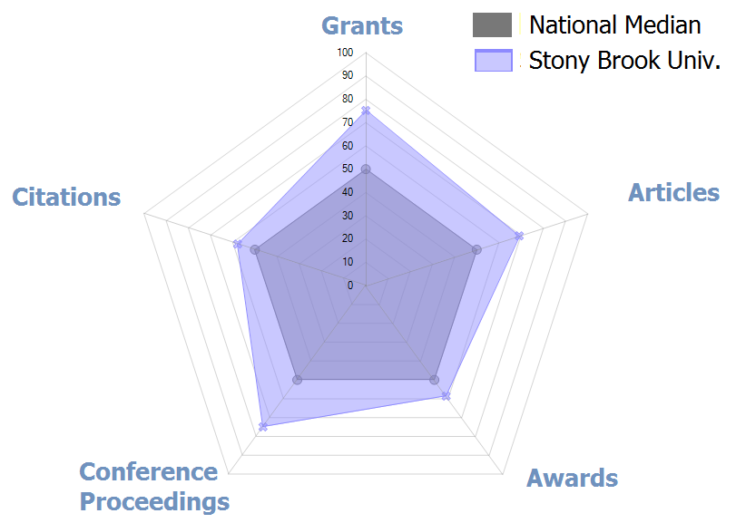
Academic Analytics
Dept. of Computer Science
Source: Academic Analytics
Notes:
Academic Analytics, which was actually developed at Stony Brook University by our former Graduate Dean Lawrence Martin, provides department-level benchmarking for research productivity. The diagram here is a small illustration of the data available. One of the challenges for IR is how to properly summarize, store, access, and retrieve relevant data for decision makers. Validating data are another challenge, since change management activities that may result from communication or use of these data will often encounter resistance that will point to anomalies in data collection or methodology (and some of these challenges are valid concerns).

Slide 41
Limitations
Extensive use of transactional data means results are not replicable
Third party algorithms prevent easy validation; some models do not follow generally accepted data mining practices (training, validation, test)
Difficulty of data cleaning in external databases
Notes:
Big data – like small data and all data – have limitations. Often one of the intended applications of data mining is to explore transactional data, and while this can be useful, when models are constructed and later applied, using frozen snapshots is necessary if analyses ever need to be replicated or validated. When using third party tools, proprietary rights may prevent you from “looking under the hood.” In working with databases external to the organization, you are often subject to data quality issues in those systems, and cleaning these data can pose particular difficulties (though often are important activities, such as ensuring faculty are correctly associated with your institution in Thompson Reuters publication databases).

Slide 42
Evolving Role of IR in Big/New Data
Sort/translate
Identify data that matter
Translate into actionable information
Validate
Ground analyses in integrity & ethics
Assure quality
Collect
Learn
Attach new data to traditional data
Extend archiving protocols
Develop skill sets
Apply new methods
Notes:
The evolution of institutional over the next decade involves using many of the same activities we traditionally valued and moving them into new contexts.
A primary function to sort information and identify what is valuable and what is not becomes more critical in a world awash with data. Filtering out noise is increasingly important
A hallmark of IR remains adherence to a code of ethics that safeguards integrity, impartiality, privacy of research subjects and pursuit of the truth was always essential. The IR Office has to rely upon its reputation to provide reliable and valuable information every time. Even minor lapses in data quality or integrity produce lasting harm.
Data collection skills and methods developed for treatment of traditional data about enrollment, degrees, and human resources need to be extended to financial data and big data projects. Promotion of replicable analyses that lead to a reproducible answer will increase in value.
Development of new skill sets and statistical methods is essential for IR professionals to remain both relevant to their institutions and engaged in their profession.

Slide 43
Building a Strong IR Function
Build a firm foundation
Definitions
Data Governance
Data Management
Master the regular communication of quality descriptive statistics
Develop capacity for inferential statistics, forecasting, modeling, and data mining
Notes:
In summary, strong institutional research begins with firm fundamentals that include establishing data definitions – preferably linked to external sources – and communicating them. Establishing data governance and data management systems and protocols pays dividends into the future. Mastery of regularized communication of descriptive statistics that are reliable and valid is key to building capital and credibility for the office. Development of capacity to apply inferential statistics, forecasting, modeling and data mining can be done in parallel with some of these foundational activities, but more advanced methods are easier to apply when the foundation is already firm.

Slide 44
Questions?
Contact Information:
Dr. Braden J. Hosch
Stony Brook University
Braden.Hosch@StonyBrook.edu
+1 (631) 632-6210

