Slide 1
WolfieONE: Employee self Service (ESS)
Changing the Employee Experience
Notes:
Welcome your audience and tell them you will be covering some changes to look forward to in the new system.
You can write down any questions to be answered later by the OCM team.

Slide 2
Agenda
Agenda
What is WolfieONE?
What does it look like?
What is HCM?
Who uses HCM?
What’s changing in:
HR forms/requests
Getting Assistance from HR
Employee Learning & Development
Performance Management
Recruiting Talent
Notes:
We will see what WO looks like, discuss a couple of modules that improve the employee experience here at Stony brook, and what is changing like
HR Requests
Getting assistance from HR
Employee learning and development
Where we will access our Performance Programs and Evaluations
Recruiting talent and how that is changing
Please note this is just a small sample of the transformative changes happening for the benefit of the employee.

Slide 3
What is WolfieONE?
What is WolfieONE?
WolfieONE is Stony Brook University's new Oracle Enterprise Resource Planning (ERP) system that will provide a more unified, transparent, and user-friendly platform for
Managing finances & business operations
Human resources
Budgeting & Planning
Notes:
WolfieONE will be replacing a Peoplesoft (but not Campus solutions), DocuSign, Taleo, the old Chart of Accounts, and Campus Budget Module

Slide 4
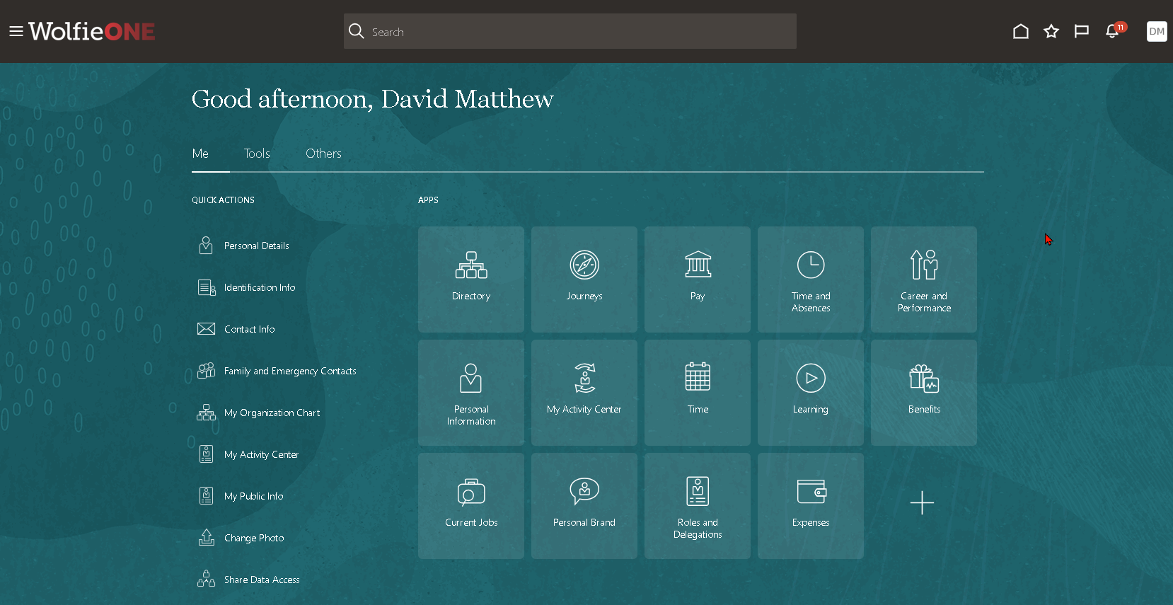
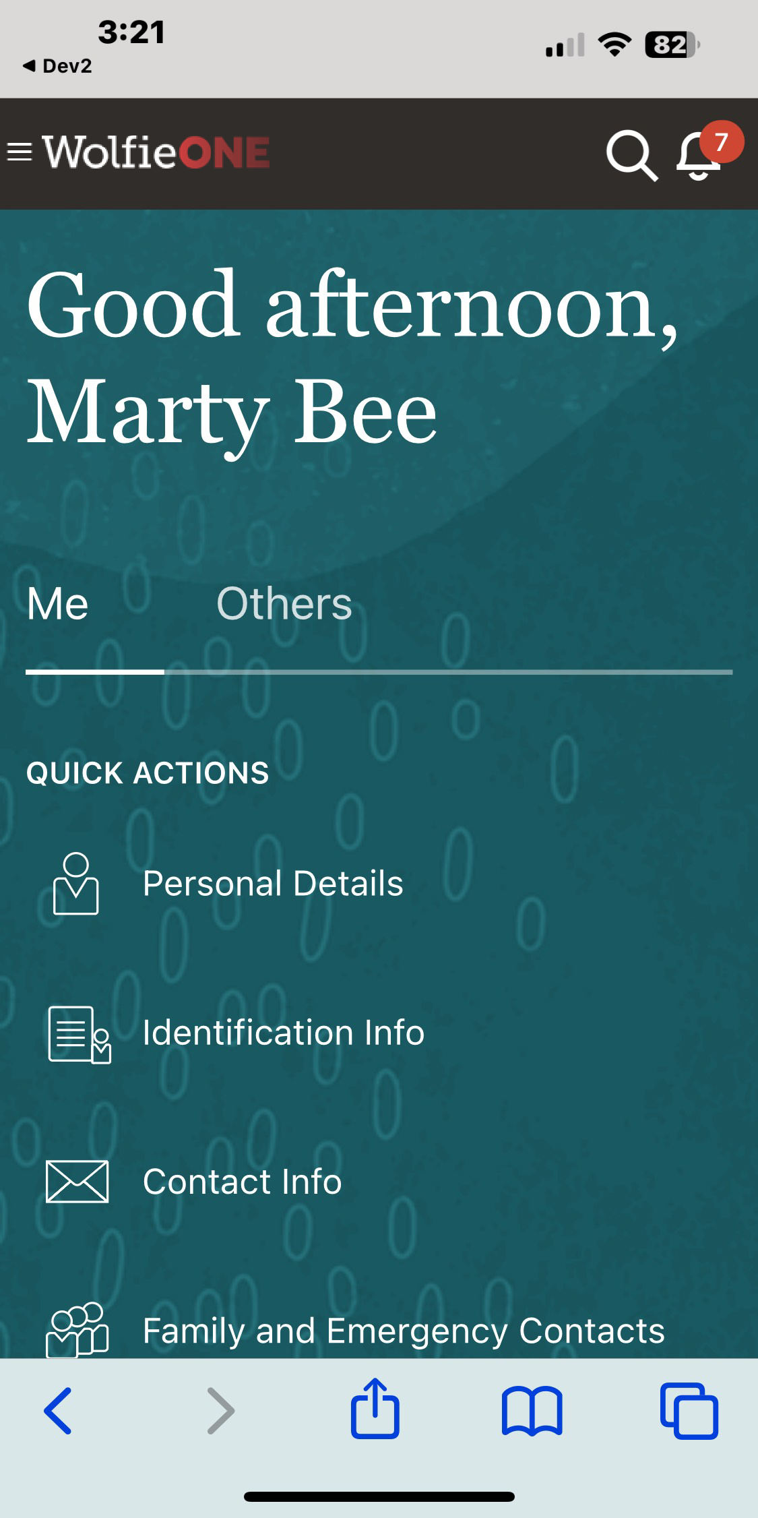
What does it look like?
What does it look like?
Notes:
As employees we will be able to do more on mobile, this includes timesheets, onboarding, professional development, and submit HR Requests.

Slide 5
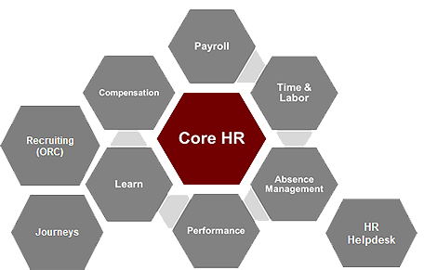
What is HCM?
What is HCM?
Human Capital Management
Human Capital Management (HCM) is a suite of Oracle modules we will use to Deliver day to day human resource Activities, reports, and requests:
Core HR
Payroll
Compensation
Time & Labor
Reporting
Absence Management
Performance & Goals
Learning
Recruiting
Journeys
HR Helpdesk
Learning
Notes:
All of these functions are now housed in one ecosystem for optimized data, insightful reporting and a better employee experience from onboarding to retirement.

Slide 6
Who uses HCM?
Who uses HCM?
Employees
Managers
HR & Division approvers
What do I do?​
What do I do?​
What do I do?
View employment and update personal information
Complete training
Review benefit options
Review Performance Programs
and evaluations
University employees submit time
Manage a team
Onboarding support
Generate reports
Evaluate performance
Review and Approve requests
Review/Approve Transactions
Track HCM trends and analytics
Generate reports
Notes:
These are personas or roles and they describe what the average person may do in these roles.

Slide 7
What’s Changing?

Slide 8
Requests to HR are Changing...
Requests to HR are Changing...
Employees are empowered to initiate multistep requests through task lists called Journeys.
Journeys are multiple tasks that complete a goal.
*Not all requests will be Journeys, some will be transactions within the system.
Notes:
One of the strengths of the Core HR module is it’s ability to digitize requests and changes
The next few slides will talk about the Current State about making to HR and the improved digitized experience with complete task lists.

Slide 9
Completing HR Forms for Changes
or Requests to Employee Records
HR Forms
Core HR
Current State:
HR change requests are made via HRS forms (PDFs)
Forms are emailed or delivered in-person.
Supporting documentation is emailed or delivered in-person.
Employees can find forms on the website or by asking HR.
Examples of requests:
Leaves, FMLA, PFL
Retirement, Resignation
Legal name changes
Future State:
All HR forms are being looked at to digitize for a better employee experience.
A Journey is a type of digitization for requests that will include all tasks to complete a goal.
(e.g. Legal name change + upload of supporting documents).
Some changes are simple and will be a transaction not a journey.
Journeys can be assigned to employees (e.g. onboarding tasks for a new employee).
Employees receive a notification and see a list of “Things to Finish” in WolfieONE.
HR Forms
Enhanced Process for Improved Employee Experience
Notes:
Current State
HR forms: https://www.asa.stonybrook.edu/asa/ASAForms/Department/HRS
Forms can be confusing.
Forms filled out incorrectly delaying the process
Additionally, the information in the forms must be rekeyed into a system by HR for the change to take place.
Confirmation of the change is not automatic and there is no transparency.
Future State
Journeys are multiple tasks organized together to reach a goal. For example a Name change journey would include
Correct spelling
Upload of supporting documentation
HR approvals
“As an employee we need to communicate with HR on changes for example a legal name change. In the current state change requests are made by filling out a form, the form is emailed or delivered in person, any additional documentation is also hand delivered or emailed. And Employees may need assistance finding the correct form. This process is being enhanced and Improved In the future state all forms are being looked at to digitize for better employee experience. A Journey is a type of digitization for requests, that contain all tasks to complete a goal. Some change are simple and will not need to be a journey. Also Journeys can be assign to employees”

Slide 10
Current State Requests as PDFs Demonstration
HRS Forms
Employee fills out a PDF or Paper-based request form after they find or request the right form.
e.g. Legal Name change, Benefits, Leaves
PDF is emailed or delivered to HR for the change.
From a group email it goes through a non-transparent approval process.
If filled out incorrectly, it may go back to the initiator.
Information/change is manually entered in a system like PeopleSoft or Oracle EBS by HR team.
Notes:
Current state: Employees or managers will fill out an HR form, email the form to HR, HR will rekey the change into PeopleSoft or Oracle EBS.
Future State: Managers can initiate the transaction in WO which automatically Routes to HR for approvals. Both manager and HR can see the evolution of the approval workflow.
Issues are:
Forms are filled out incorrectly for example sometimes the effective date needs to be the start of a payroll period ex: giving your student employee a raise.
Rekeying of information is time consuming and can have errors.
Notifications rely on emails; emails fall through the cracks no analytics
Finding the correct HR forms can be time consuming
No visibility into the approval process.

Slide 11
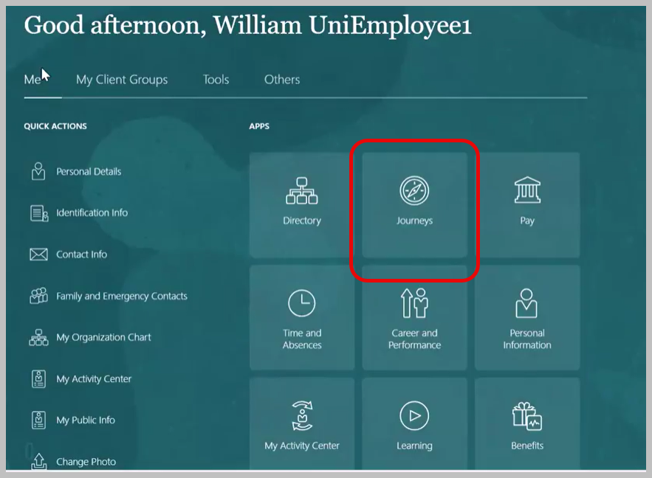
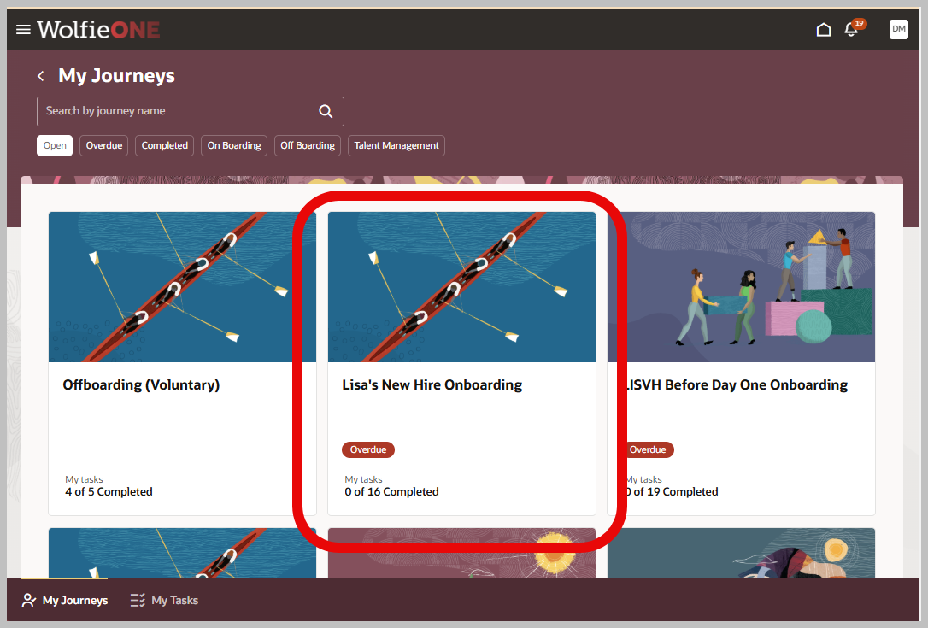
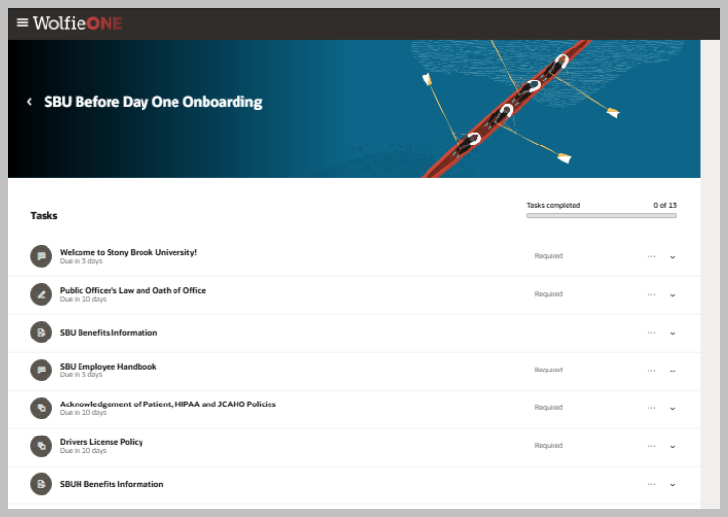
Future State Requests as Journeys Demonstration
Example:
address or phone number change
Examples:
A legal name change will require
Spelling of new name
Uploading supporting documents
New Hire Onboarding will require additional tasks.
Welcome
Policies
Benefit Information
More…
Click to view screenshots of an Onboarding Journey:
Some requests are simple changes that will not be a journey.
Click on Journeys
Choose your journey
Finish each Task
Some are Journeys.
These are multi-steps tasks.
Notes:
Journeys streamline and organize tasks to fulfill a goal. Like a legal name change or new hiring orientation tasks.
NOTE: Journeys are relevant to the employee. For example, a new employee journey will not appear for a current employee.
In addition to Journeys, Oracle provides a Things to Finish area that to ensure that every employee at every role does miss a thing to finish.

Slide 12
Start
Stop
Continue
Login to WolfieONE and begin a journey for many requests.
Check WolfieONE for
Alerts
Things to finish
Stop using paper-based forms for requests.
Stop sending emails to make or check on requests.
Continue working as before and meet with HR about your request as needed.
Login to WolfieONE and initiate a journey for many requests.
Check WolfieONE for approval updates and Alerts.
Login to WolfieONE and initiate a journey for many requests.
Check WolfieONE for approval updates and Alerts.
Login to WolfieONE and initiate a journey for many requests.
Check WolfieONE for approval updates and Alerts.
Notes:
“So upon go live, log into wolfieone and use Journeys to organize all of your tasks to complete a goal, No need to use paper based forms for requests and no need to make or send requests by email. However continue to work as before and meet with HR about your requests as needed.”

Slide 13
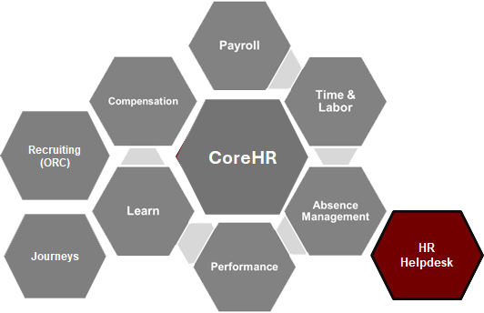
Getting assistance from HR
Getting assistance from HR
HR Helpdesk
Learning
Notes:
Getting Assistance from HR is automated and tracked.
“Getting Assistance from HR using the HR HElpdesk.”

Slide 14
HR Helpdesk
Getting assistance from HR
Current State:
Phone call or Email for HR Assistance.
Seek information on the website.
Future State:
Create a ticket for assistance in WolfieONE.
Current and past requests are available in WolfieONE.
Suggested help articles appear during ticket creation.
Tickets are escalated to correct groups within HR.
Tickets are tracked for completion rates; analyzed for trending cases.
Supports data security and privacy.
Improved issue tracking for HR requests
Notes:
“In the current state we call or email hr for help or seeking information on the web site. Hr requests will now have improved issue tracking. We can create a ticket, view current and past requests in WO, and view help articles that read what we are typing to provide us answers quickly. Tickets are escalated to correct groups within HR and are tracked for timely completion rates and analyzed for trending cases. Tickets support data security and privacy.”

Slide 15
Start
Stop
Continue
Request assistance through the HR Helpdesk.
Check for updates in HR Helpdesk.
Search Knowledge articles in the HR Helpdesk.
Stop sending emails for assistance.
Continue seeking guidance from HR.
Working as usual.
Working as usual.
Notes:
“So in the future state we will get assistance by creating tickets with in the HR Helpdesk, we can check for updates to our requests and search the knowledgebase for answers. We no longer will need to send emails and we will be able to continue to seek guidance from HR but in an improved streamlined way.
“

Slide 16
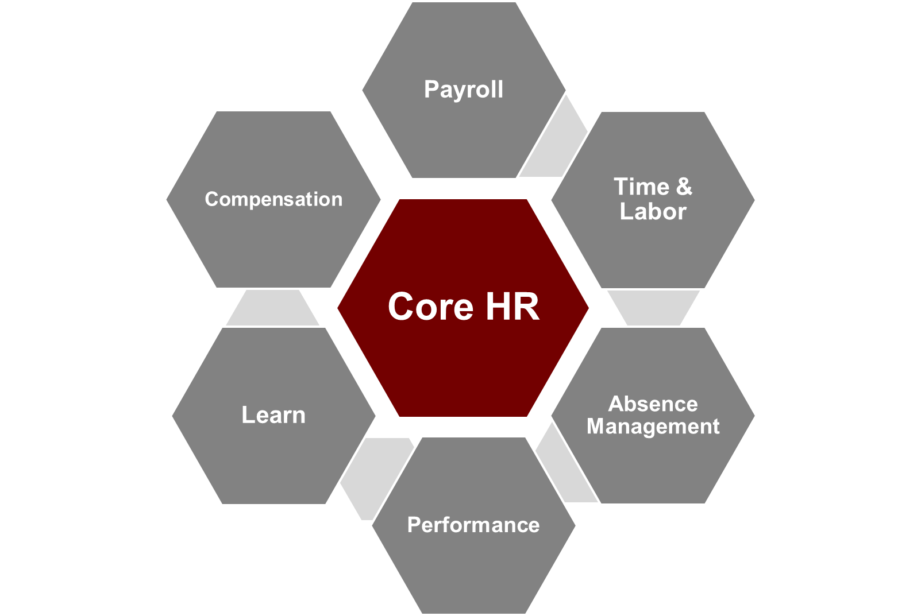
Employee Learning & development
Employee Learning & development
Learning Module
CoreHR
Recruiting (ORC)
Learning
Journeys
HR Helpdesk
Notes:
HR training will be located in WolfieONE. You can register for workshops or drop from the registration. View course materials and take tests. Attendance and completion rates are recorded.
“The Learning Module in Wolfie one will provide employees with professional development.”

Slide 17
Learning
Training Opportunities for Employees
Current State:
Various training sites for Professional Development.
Training materials are distributed across multiple platforms and are not housed in one location.
Registration is managed through various platforms or systems.
Data collection, completion rates, and certificates of completion are sometimes manually processed.
Notices of training via email can be missed.
Future State:
Learners Can
Access Training offered in WolfieONE.
Access certificates of completion in WolfieONE.
Receive various training notifications within WolfieONE.
Browse and self-enroll into courses.
Request cancellations and this will automatically open seats for other learners.
Request to be waitlisted for a full course.
Comprehensive training is available in WolfieONE to improve Employee Experience.
Notes:
“In the current state: Training opportunities in WO are on various platforms and training sites, registration is also managed through various platforms and data collection and completion rates as well as certificates are very manual processes. Notices of training is by email. WO’s comprehensive Learning Module improves the employee experiences where learners are offered training to browse and receive certificates in WO. Notifications of training are withing WolifeONE. Also learners can cancel their seat for a training which will automatically open seats for others. And there is a waitlist feature when a course is full.
“

Slide 18
Start
Stop
Continue
Browsing Learning for available courses in WolfieONE.
Viewing Course materials and dates in WolfieONE.
Accessing Certificates of Completion in WolfieONE.
(There is no equivalent to a unified learning management system in the current state.)
Continue completing required training courses.
Continue taking trainings in Salute, Veoci, Citi training system and Healthstream.
Continue to use Brightspace for School of Health Professionals.
Browsing the Catalogue for soft skills training
Checking your compliance training due dates in WolfieONE
Seeking assigned training
Waiting for compliance training in email
Continue Professional development goals every year
Notes:
Students do not have access to WolfieONE.
Salute is Health and Safety (Lab trainings).
“So upon WO go Live, employees may brows for learning in WO, View course due dates in WO, and access their Certificates of completion in WO. (There is no current equivant to a unified learning management system in the current state.) We will continue completing required training courses and note not all training will be in WO so please continue to use Salute, Veoci, Citi, healthstream and brightspace as directed by your department
“

Slide 19
Accessing your duties and performance
Accessing your duties and performance
Performance and Goals in WolfieONE
CoreHR
Recruiting (ORC)
Learning
Journeys
HR Helpdesk
Performance
Notes:
Performance Programs and Evaluations are digitized.
“The performance module in WO will provide us access to our programs and evaluations. “

Slide 20
Performance Management Improvement
Performance
Current State:
Performance evaluations and programs are PDFs, separate from any system.
Employees can ask HR for evaluations and programs or save them to their own drives.
Performance evaluation is a manual process.
Programs and evaluations are not automated.
Future State:
Employees can:
View and engage with digitized performance programs and evaluations anytime directly in WolfieONE.
Access the latest Program and Evaluation upon WolfieONE Go Live and all subsequent evaluations and programs thereafter.
Receive yearly evaluations on a schedule with automatic notifications.
Notes:
“In the current state PP and PE are pdfs separate from any system, Employees can ask HR for their PP and PEs if they didn’t save them. Performance evaluation is a manual process, and are not automated. In the future state, employees may view digitized PP and PEs any time in WO, They may access the latest PP and PE in WO and all subsequent evaluations and programs there after Go Live. Also employees will receive evaluation on a schedule because of WO’s ability to provide automatic scheduled notifications.
“

Slide 21
Start
Stop
Continue
What should we start doing?
Is there a tool, process or resources that would help us achieve our goals?
What strengths do we have that we aren’t currently leveraging?
Stop completing paper forms.
Stop saving and storing programs and evaluations on a separate drive.
Continue following current program and fulfilling duties.
Continue fulfilling professional development goals.
Continue seeking feedback and having conversations with your manager throughout the year on performance and goals.
Start checking WolfieONE for alerts on upcoming Evaluations. (Evaluations will be Journeys that appear during the evaluation period.)
Start logging into WolfieONE to review program and evaluations.
What should we stop doing?
What do we do that takes up a lot of resources but doesn’t produce results?
Is there a tool or process that isn’t working the way is was intended to?
What are we doing right that we need to continue doing?
What works well that shouldn’t change?
(e.g. Jaggaer, Concur)
Notes:
“So upon Go live check WO for alerts on upcoming evaluations and log into WO to review your PP and PEs. No need to fill out or sign paper forms and no need to save and store programs on a separate drive. We will continue to follow our programs to fulfill our work duties, continue to fulfill our PD goals, and continue to seek feedback and have conversations with our managers throughout the year on performance and goals.
“

Slide 22
Explore Job Opportunities and Update Your Profile
Explore Job Opportunities and Update Your Profile
Recruiting – Oracle Recruiting Cloud (ORC)
CoreHR
Recruiting
(ORC)
Learning
Journeys
HR Helpdesk
Notes:
“The final topic is on how employees can explore job opportunities and update their skills in the Recruiting module of WO.”

Slide 23
Explore Job Opportunities
and Update Your Profile
ORC
Current State:
Taleo is used as the recruiting tool for staff.
Current staff access Jobs site on: stonybrook.edu/jobs
Communication with candidates is through email.
Future State:
Current employees access postings and apply for staff jobs within WolfieONE.
Current employees will have a quicker application experience.
Better filtering capabilities to find the right jobs, tailored search.
Managers and recruiters can search internally for skill sets, better visibility. Leveraging “best fit analysis”.
Communication is consolidated into WolfieONE so there is little chance of missing emails.
Notes:
“In the current state we use Taleo to seek and apply for jobs on the stonybrook.edfu/jobs site. Communication with candidates is through email.
This process will be improved. In the future state, current employees can seek opportunities and apply for jobs within WO. The application process is quicker! There are better filtering capabilities fo help employees tailor their job search. There is better visibility into current employees skills sets or profiles for hiring managers and recruiters to leverage. And communication is consolidated into WO so there is little chance of missing emails.”

Slide 24
Start
Stop
Continue
Seeking new opportunities within WolfieONE.
Updating your skills and experience in WolfieONE.
Leveraging WolfieONE's filters and search tools for more precise and organized job search results.
Stop using Taleo (after WolfieONE Go Live).
Continue seeking growth and new opportunities within the campus community.
What should we start doing?
Is there a tool, process or resources that would help us achieve our goals?
What strengths do we have that we aren’t currently leveraging?
What should we stop doing?
What do we do that takes up a lot of resources but doesn’t produce results?
Is there a tool or process that isn’t working the way is was intended to?
What are we doing right that we need to continue doing?
What works well that shouldn’t change?
(e.g. Jaggaer, Concur)
Notes:
Faculty will continue to use Interfolio
“Upon go live, employees will seek new job opportunities withing WO, We can update our sills and experience in our profile sof WO and leverage WO’s better filtering and search tools for more precise and organied job search. We will no longer log into Taleo and search for jobs. However we may continue seeking growth and new opportunities within the campus community.
“

Slide 25
Questions?

Slide 26
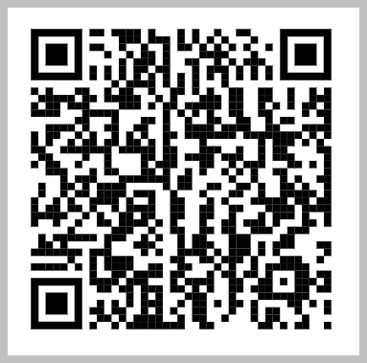
Questions and Feedback
Questions and Feedback
WolfieONE suggestions or feedback:
Please fill out a
survey
ocm@stonybrook.edu
QR code
to survey
Notes:
“For any questions or feedback please take some time to fill out the Wolfieone Suggestions or Feedback survey.

